Slide 1
Electron Charge to Mass Ratio

Slide 2
Theory (1/2)
Hypothesis: given an electron beam in a constant magnetic field, the charge to mass ratio will be a constant
We know the kinetic energy of an electron
We also know that magnetic and centripetal force are equal
Solve for e/m, substitute

Slide 3
Theory (2/2)
B is known for Helmholtz coils
N = 130 and a = 0.158m for the lab equipment
The accepted value is approximately 1.6e-19 / 9.1e-31

Slide 4
Setup Procedure (1/5)
This lab works with high voltage (500V), electron beams
This lab is in the secondary lab room
Turn off all power supplies
Connect the high-voltage DC power to the accelerating voltage
Connect the low-voltage DC power supply to the Helmholtz coils
  Ensure current flows through both coils, not just one
Connect the low-voltage AC power supply to the filament
Verify connections are in-place with instructor before energizing

Slide 5
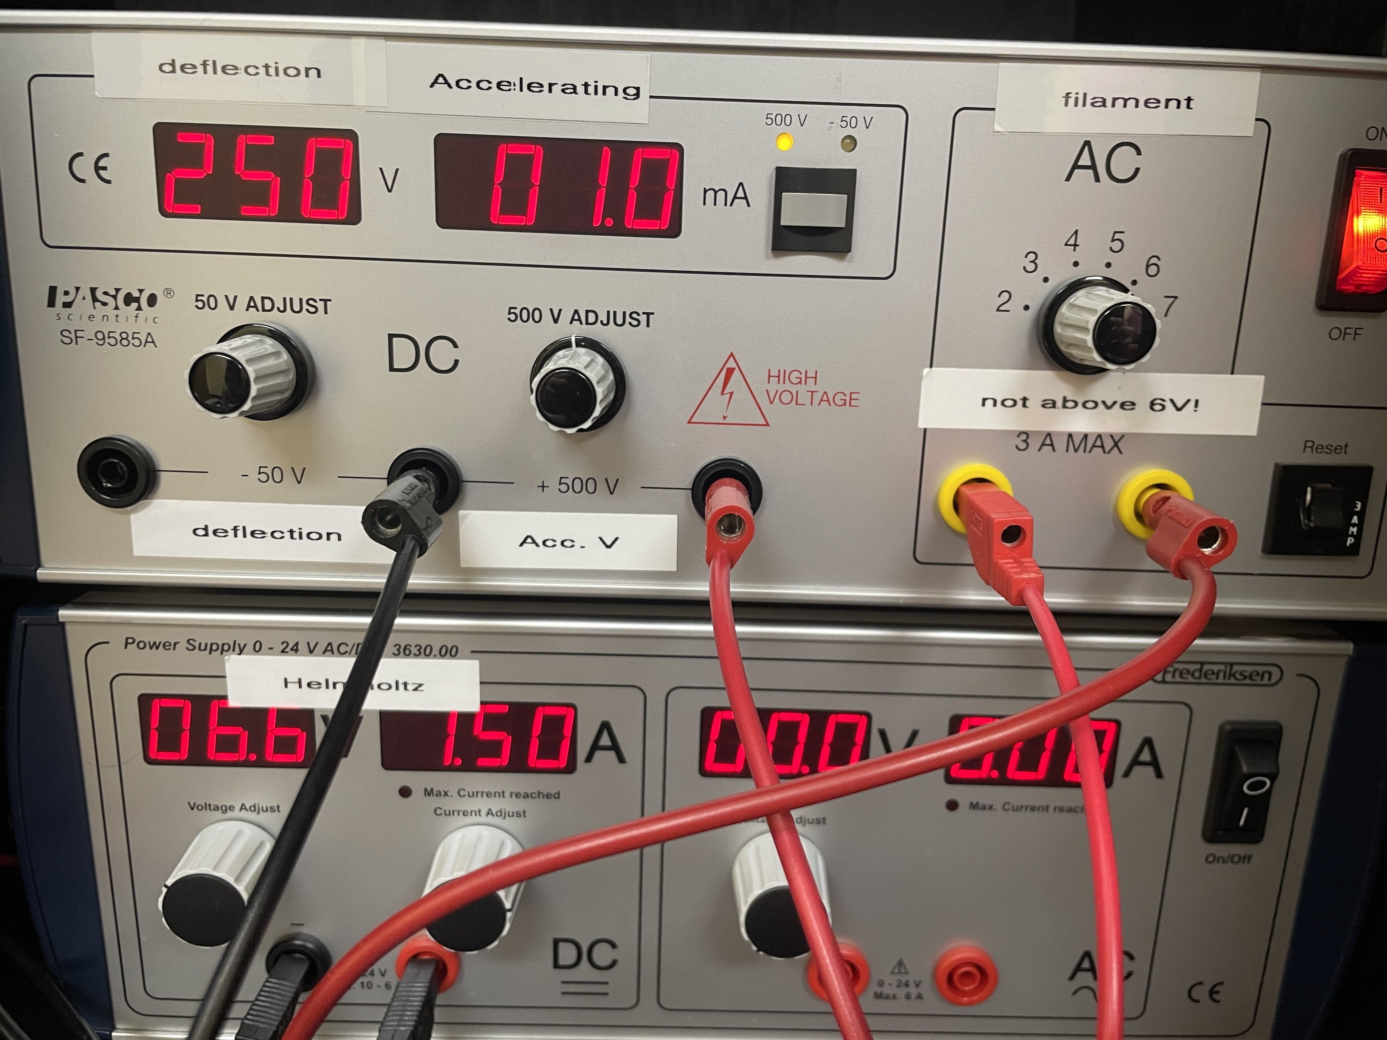
Setup Procedure (2/5)
Proper terminals to use seen to the side
Your power supplies should not be on at this state

Slide 6
Setup Procedure (3/5)
Cover lab with hood if needed
When energizing and controlling voltage, increment voltage slowly
When energizing and controlling both voltage and current, increment current slightly, then voltage slightly, and continue alternating
  Failure to do so will lead to surges

Slide 7
Setup Procedure (4/5)
Energize filament to 6ADC (do not exceed at risk of equipment damage)
Energize accelerating voltage to 150-250VDC
  The specific power supply must be toggled between the 50/500V readout using the small button
Energize the Helmholtz coils to 4-7VDC (max 2A)
  Limit current to ¾ of the full range. Ensure you are using the leftmost outputs of the power supply.
  Exceeding or approaching 2A will lead to the beam nearing the edge of the tube and diffracting or reflecting

Slide 8
Setup Procedure (5/5)
Wait several minutes for the filament and tube to heat up
  Safety: Do not touch the glass (risk of thermal burns and electrocution)
The electron beam will appear and be curved by the coils. If it fails to do so, gently curve the base.
  Turn the lights off and close the door
Output variables are U_acc, I and r
  Accelerating voltage, current through the coils, and radius of the beam

Slide 9
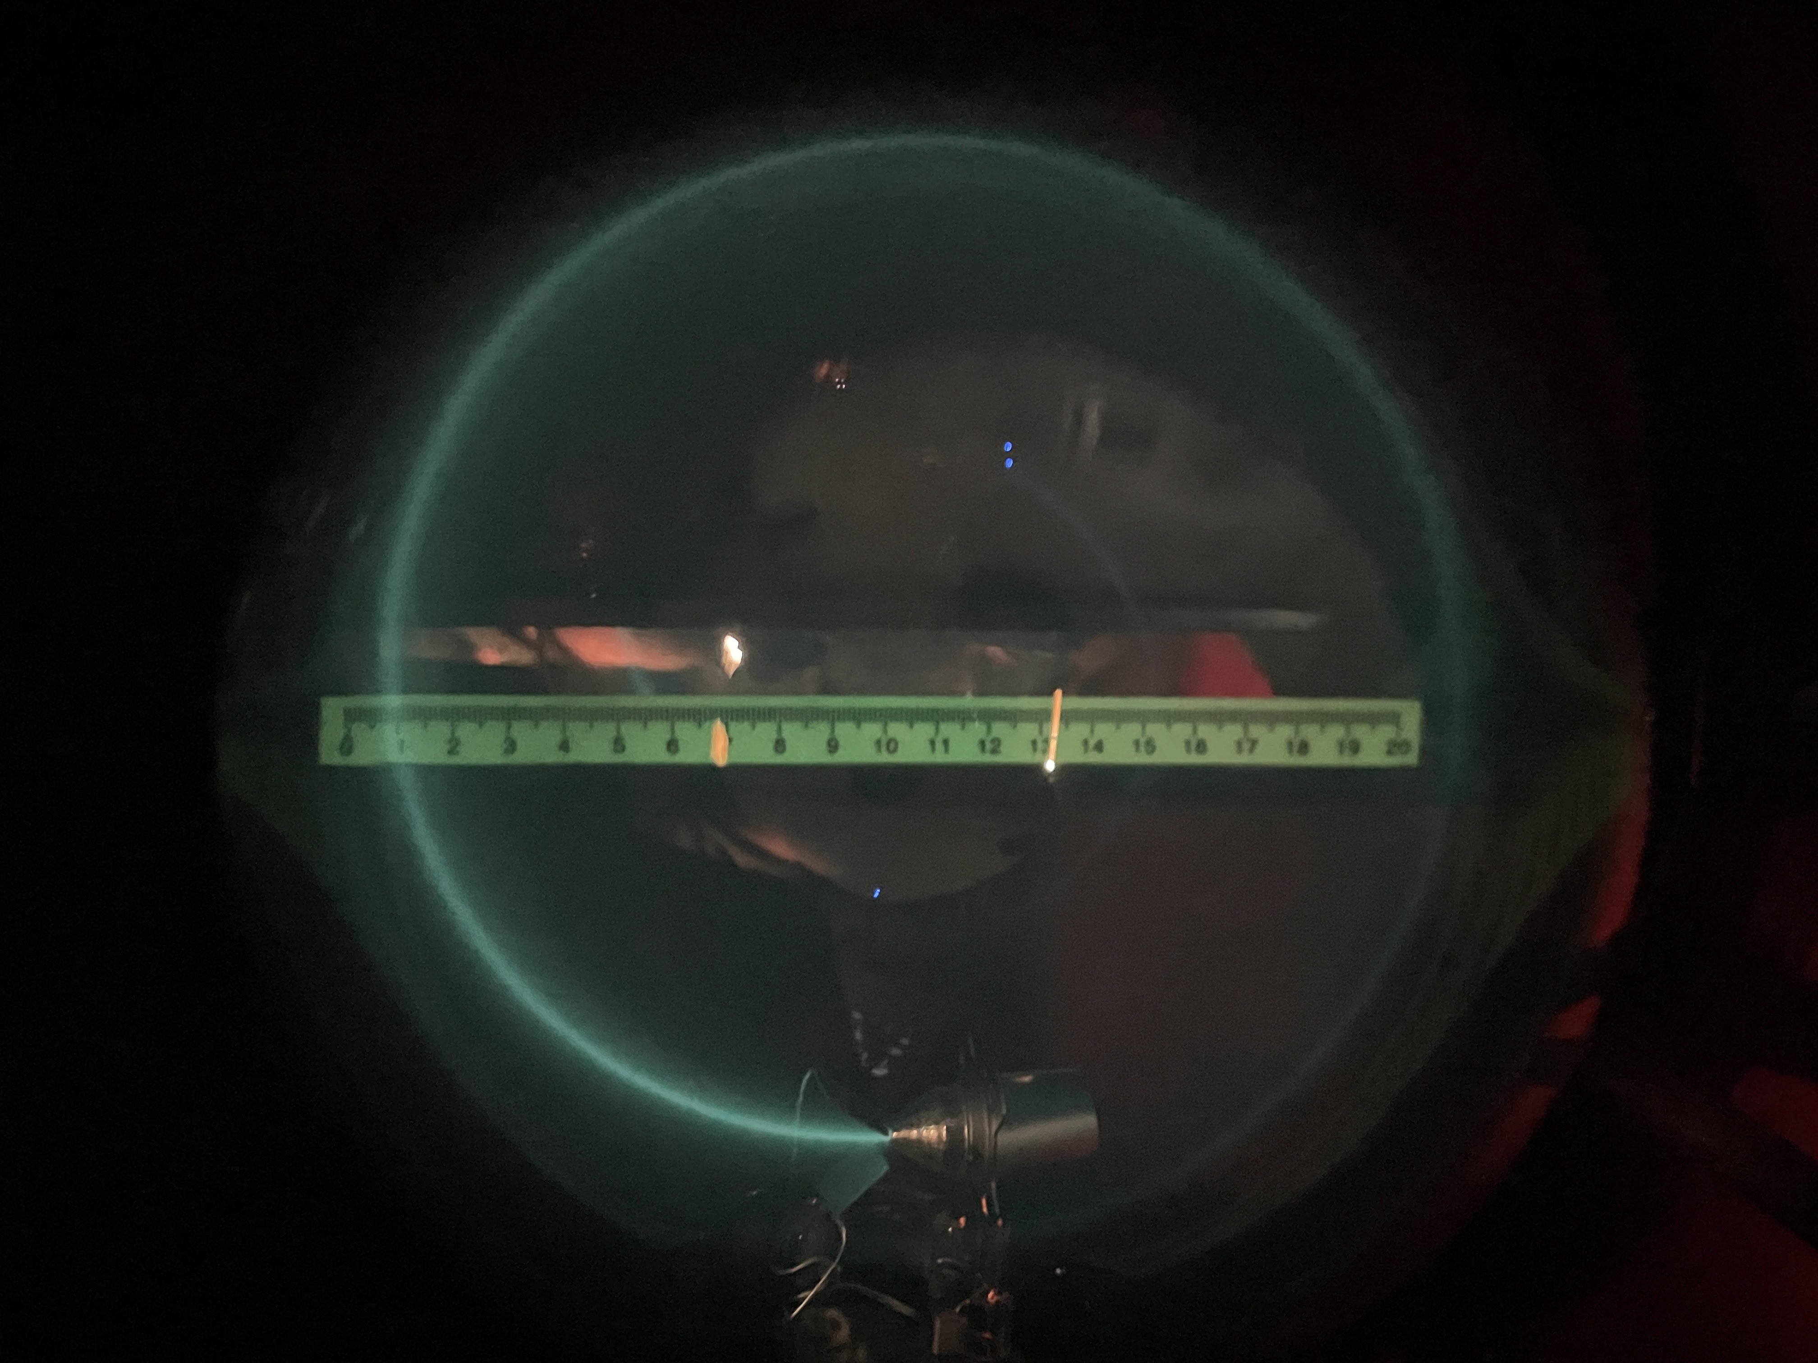
Electron Beam
Dark room required to see

Slide 10
Measurement Procedure
Suggested starting parameters for measurement are U_acc = 200V, I_coil = 1.2A
Rotate the tube to obtain a straight circular path
Read and record I_coil (current to Helmholtz coils)
Measure the radius of the electron beam and estimated error
Take at least ten measurements for U_acc in 150-250VAC and constant current I_1
Repeat the same measurements for the chosen U_acc for a second current I_2

Slide 11
Cleanup
Reduce all voltages to zero
  Ensure this is done gradually to avoid sharp cutoffs, reverse EMF, back-current, or other issues
Turn off all power supplies
Disconnect all wires

